Slide 1
Unifield Textiles Limited

Slide 2
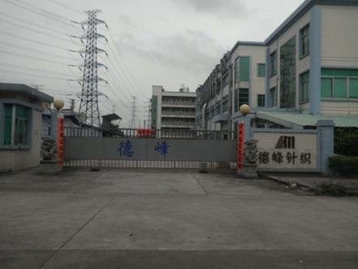
Knitting/dyeing facility
Founded in 2012 as a basic knit fabric manufacturer catering for small to mid size clients.

Slide 3
Unifield has since gained the reputation of being Flexible, nimble, QR, professional and innovative: served customers like Nautica, Ralph Lauren, Ann Taylor, Lands End, Tommy Bahama, Bonobo, Rail,
Currently …
Transform from traditional “order base” into “development driven” business model
Has Over 10 expert teams catering various clients in different markets
With concept and design teams in New York capturing updated fashion trends
Ability to innovate becoming the leader of the industry that makes influences
Collaborate with our brand partners to enhance consumers’ experience through product innovation, product aesthetic, and
inspirations.

Slide 4
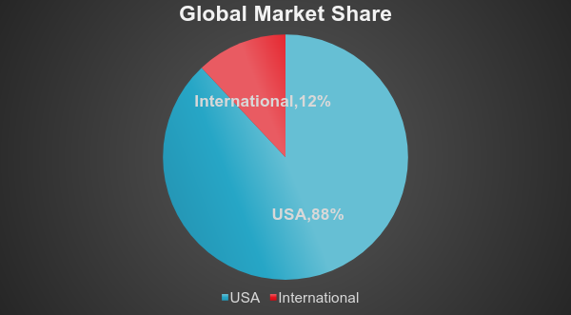
Unifield Market Distribution

Slide 5
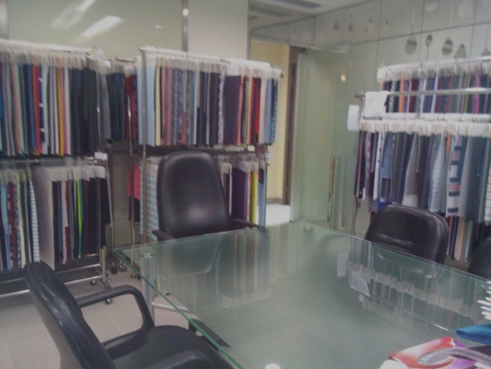
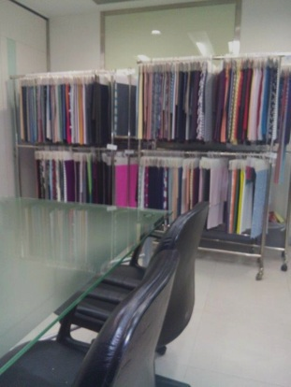
Offices
Hong Kong Office

Slide 6
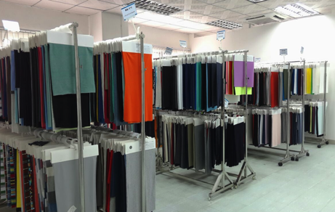
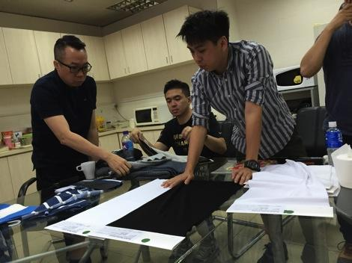
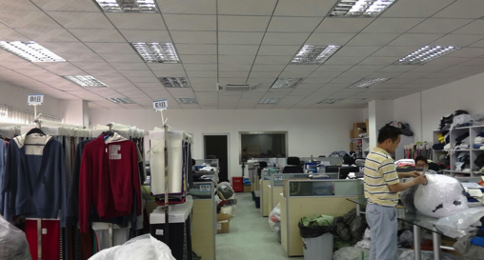
Shenzhen office

Slide 7
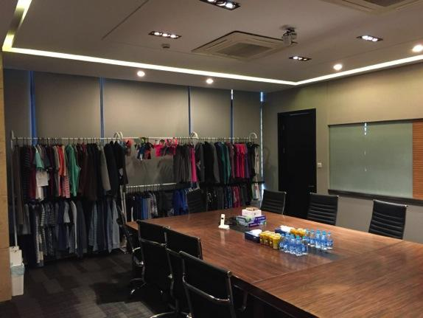
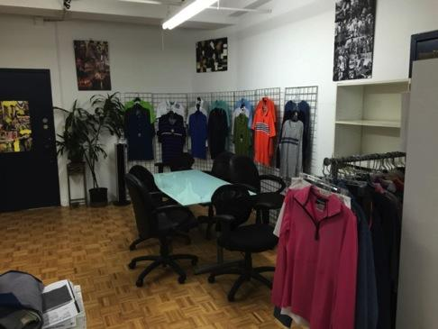
Shanghai Office New York Office

Slide 8
Business strategy
Market Research
Product Development
Supply Chain Management

Slide 9
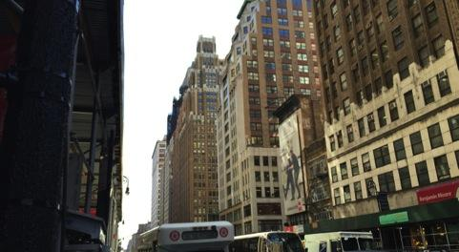
Market Research
-NY presence
-Close to the market

Slide 10
Market Research - Learning the Market

Slide 11
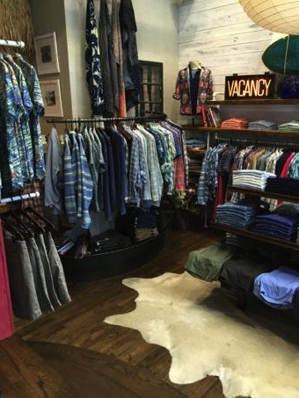
Market Research – the Touch, a connection with the Brands

Slide 12
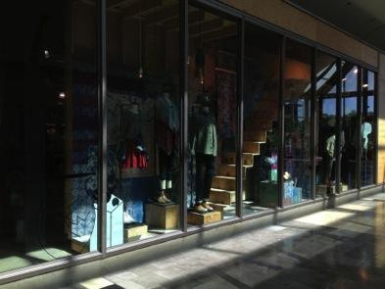
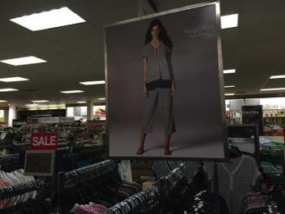
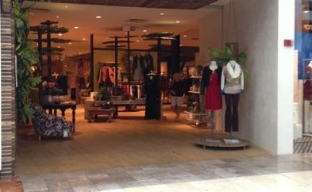
Market Research – Capturing the trend

Slide 13
Product Development – Continue to explore and develop new products that fit our clients

Slide 14
Product Development – Trend Forecast/Concept boards

Slide 15
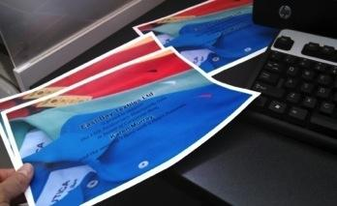
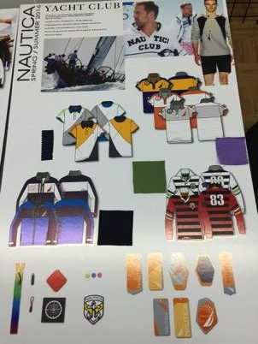
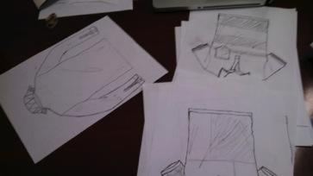
Product Development – Filling the Missing Piece
Identify and suggest products that would fit in the specific brand, i.e filling the “missing piece”

Slide 16
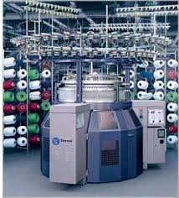
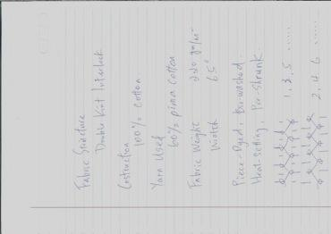
Product development- Study, analyze, and process….

Slide 17
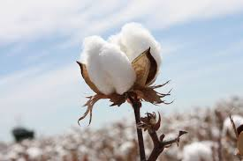
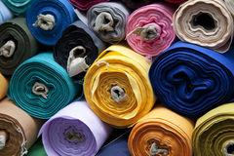
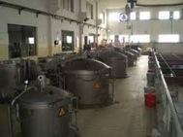
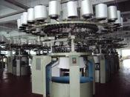
Supply Chain Management - from Raw material to aftersales service

Slide 18
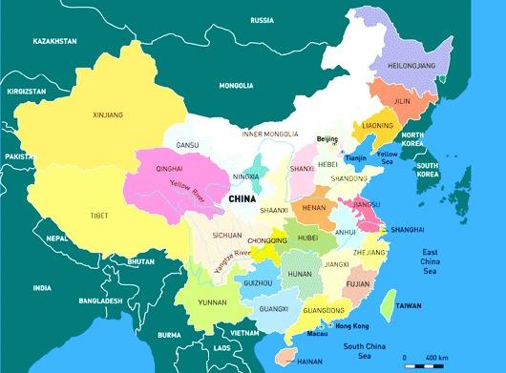
Supply chain management
Carry out comprehensive evaluation on raw materials, yarns, dye chemical, machines, engineering and craftsmanship, human resources, logistics, and service level, to strive to achieve an efficient, cost effective and streamlined supply chain for the product.

Slide 19
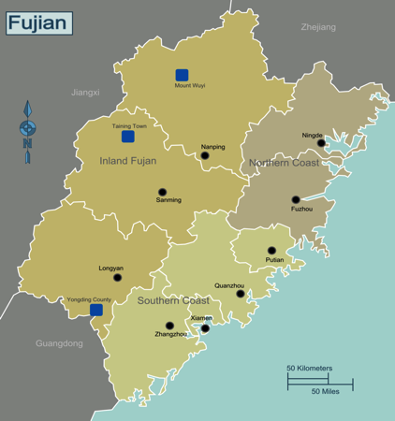
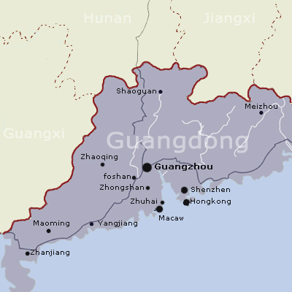
Supply Chain Management
Guangdong Area
Cotton chief products
Small business
Flexible and quick response
Example : Timberland
Fujian Area
Polyester/Nylon Filament product
Wide Range of raw material
Perfect production engineering
Example: Golf Brand Titleist

Slide 20
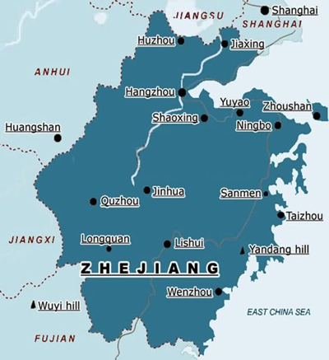
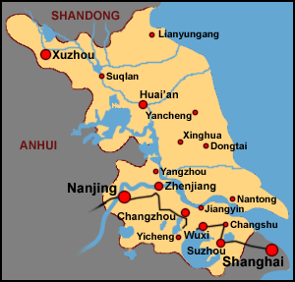
Supply chain management
Zhejiang Area
Regenerated fiber product
Variety of print product
Competitive cost
Example: DKNY
Jiangsu Area
Fashion and blended raw
materials, eg Linen and
wool
Novelty knits
Value added finishing
Example: Lauren

Slide 21
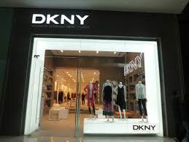
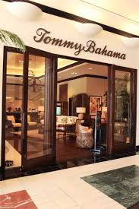
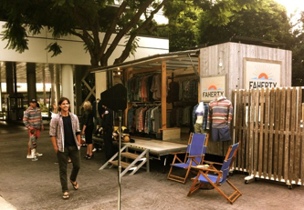
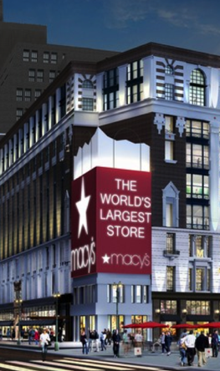
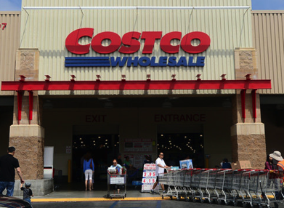
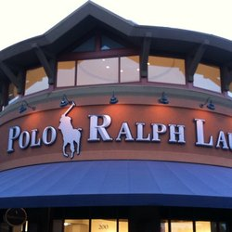
Our Partners

Slide 22
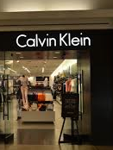
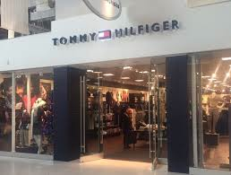
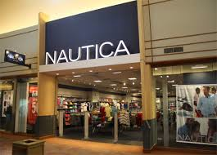
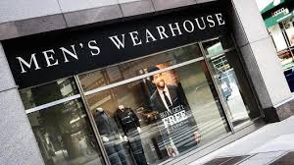
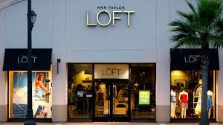
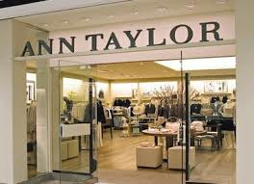
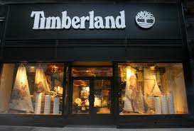

Slide 23
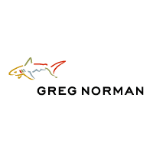
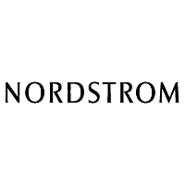
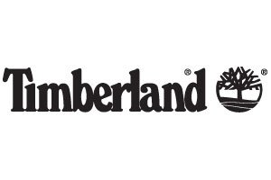

Slide 24
Contact us
TEL 電話 : (852) 2370 3698
FAX 傳真 : (852) 2307 5192
E-MAIL 電郵 : info@unifield.com.hk
THANK YOU

